Slide 1
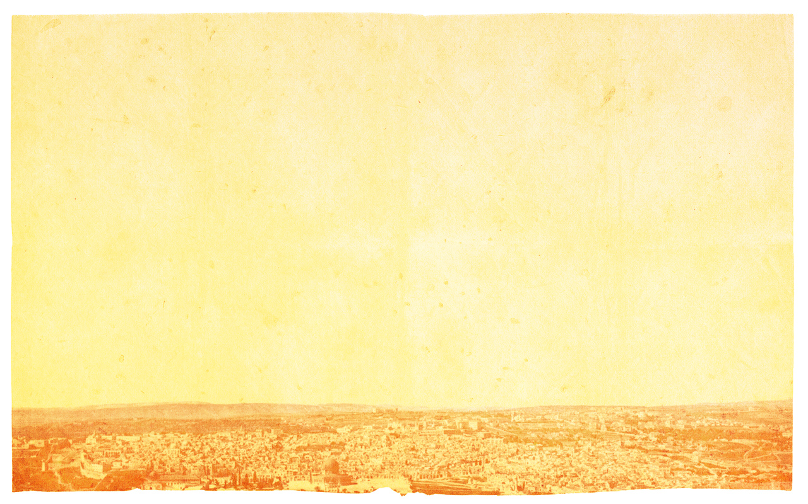
THE MINOR PROPHETS
An Introduction

Slide 2
What do you think about when you hear “Minor Prophets”?
Does something like this come to mind?

Slide 4
Romans 15:4 “For whatever was written in former days was written for our instruction, that through the encouragement of the Scriptures we might have hope.”
2 Timothy 3:16-17 “All scripture is breathed out by God and is profitable for teaching, for reproof, for correction, and for training in righteousness, that the man of God may be complete, equipped for every good work.”

Slide 5
Who were the Prophets?
How are they classified?
When were they written?
How can I better understand them?
Why study the Minor Prophets?

Slide 6
Who were the Prophets?
A spokesman for God (2 Peter 1:21)
Primarily a “forth-teller”
Sometimes a “fore-teller”
The Prophets mission was to call Israel back to the Lord.

Slide 7
II. How are they classified?
The Major Prophets: Isaiah-Daniel
The Minor Prophets: Hosea-Malachi
It was Augustine who was first credited with classifying them this way.
The distinction pertains ONLY to the length of the books.

Slide 8
III. When were they written?
Pre-Exilic:
Hosea- 755-715
Joel- 835
Amos- 765-760
Jonah- 780
Micah- 740-690
Nahum- 630-612
Habakkuk- 606-604
Zephaniah- 625

Slide 9
III. When were they written?
Pre-Exilic:
Exile:
Obadiah

Slide 10
III. When were they written?
Pre-Exilic
Exile
Post-exilic:
Haggai-520
Zechariah- 515
Malachi- 430

Slide 11
IV. How can I better understand them?
Seek to understand the political, social, and religious settings of the times.
Consider God’s relation to the “heathen” (any nation that is not Israel).
Note any teaching regarding the Messiah and His coming Kingdom.
The immediate mission of most prophets was to save God’s people from idolatry and wickedness.
Following that, they were sent to announce God’s judgment.
Many prophets left a message of hope of the coming Messiah.

Slide 12
V. Why should I study the Minor Prophets?
In the Minor Prophets we can learn about…
The nature of God- His holiness, justice, righteousness, and mercy.
The workings of God- as He dealt with nations, brought judgment upon the guilty, saved His people, foretold of hope to come.
All of this can help us in our relationship with God today, and can give us comfort and hope as we are rminded that He is in control

